Slide 1
Advances in Surgical and Medical Options for the Treatment of Pancreatic Cancer
Dr. Melissa E. Hogg MD MS
Dr. Mark Talamonti MD
November 10, 2021

Slide 2
Disclosures

Slide 3
Agenda: What’s Happening At Northshore
Multi-Modality Therapy for Pancreatic Cancer
Clinical Trials at Northshore
Multi-Institutional Program Opportunities
High Risk Clinic
Minimally Invasive Approach to Pancreatic Surgery
Training the Next Generation

Slide 4
Multi-Modality Therapy for Pancreatic Cancer

Slide 5
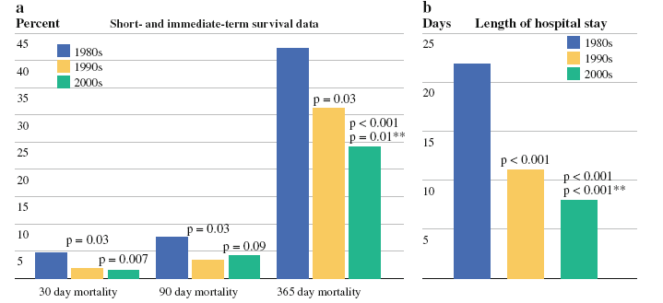
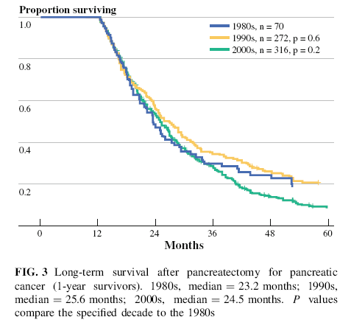
Lack of Progress over 3 Decades

Slide 6
CONKO-001 (Adjuvant Gem = Good)
Notes:
The reason for this is that pancreas cancer is a systemic disease in most cases at diagnosis. This matters because our therapies must reflect the biology of the disease. This was demonstrated to be clear in the Conko-001 trial which showed that adjuvant chemotherapy with gemcitabine improved OS and DFS which was an effect consistent in all subgroups. Again, this study confirmed pancreas cancer can not only be treated with local therapy but also with treatments that will affect the systemic disease

Slide 7
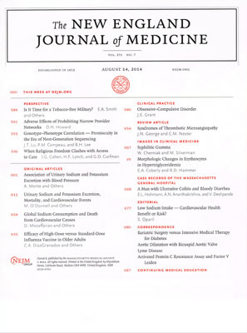
ESPAC1 (Adjuvant CXRT = Worse)

Slide 8
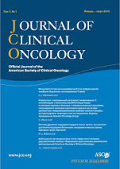
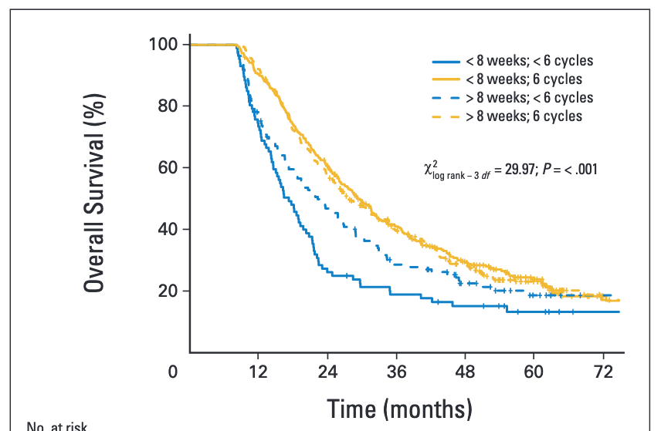
Duration of Adjuvant is Significant [ESPAC-3]
Time to start chemotherapy not significant on MVA
Completion of 6 cycles vs. Completion of 1-5 cycles improves survival on MVA (HR = 0.51)

Slide 9
ESPAC 4: Gem/Cape vs Gemcitabine

Slide 10
Adjuvant FOLFIRINOX

Slide 11
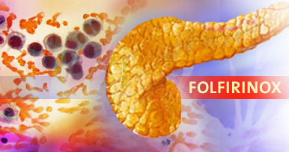
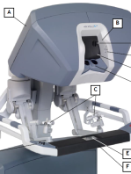
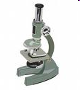
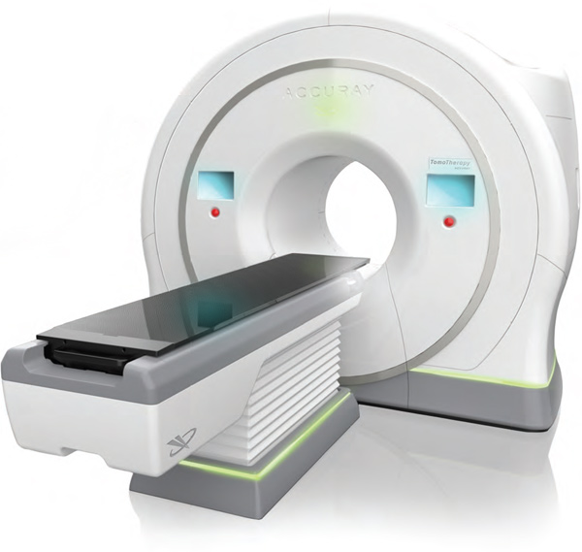
Change In Paradigm: Ideal Timeline
MDC Clinic
Neoadjuvant
Chemotherapy
Re-Stage
Robotic
Surgery
Tumor Board
XRT
Adjuvant
Chemo.
D29
Off
D15
D8
D1
D36
D43
Off
Margins:
Positive (R1)
2-6
months
0 day
2 weeks
12 weeks
14 weeks
15 weeks
20-26 weeks
CT Scan
CA19-9
Gem/Abraxane
FOLFIRINOX
CT Scan
CA19-9
Whipple
Distal
Margins
Response
6 cycles

Slide 12
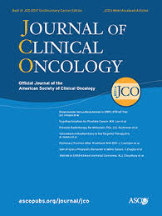
Benefits of Neoadjuvant Approach
Decreased T stage
Decreased N stage
Increased R0 resection
Better Survival
Weed out early progression
Less Fistula
Less Complications

Slide 13
Neoadjuvant Therapy Mitigates Complications

Slide 14
NorthShore Progress in Last Few Years
Neoadjuvant: 33% → 82%

Slide 15
Stage On Presentation

Slide 16
Clinical Trials at Northshore

Slide 17
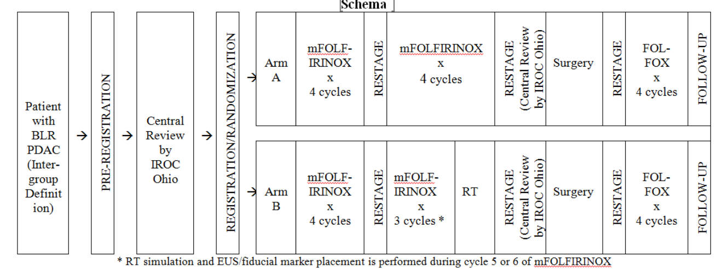
ALLIANCE A021501 Borderline Trial
What is the Optimal Regimen?
XRT Yes or No?

Slide 18
Without vs. With SBRT
Neoadjuvant mFOLFIRINOX favorable OS compared to historical
Addition of SBRT does not improve OS

Slide 19
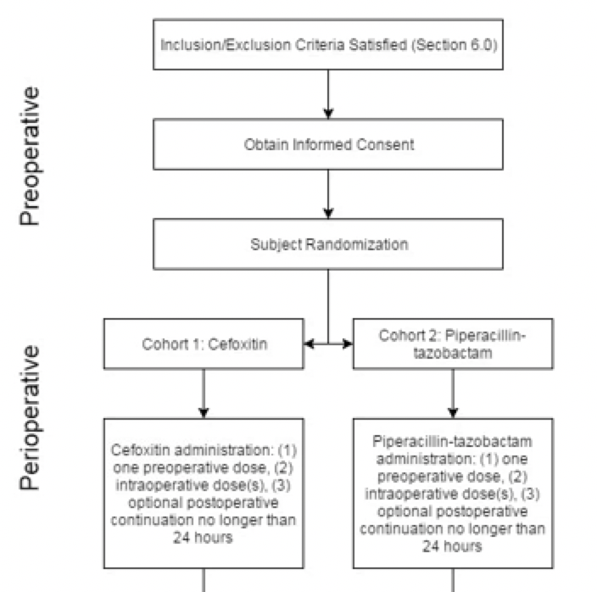
Peri-Operative Outcome Optimization

Slide 20
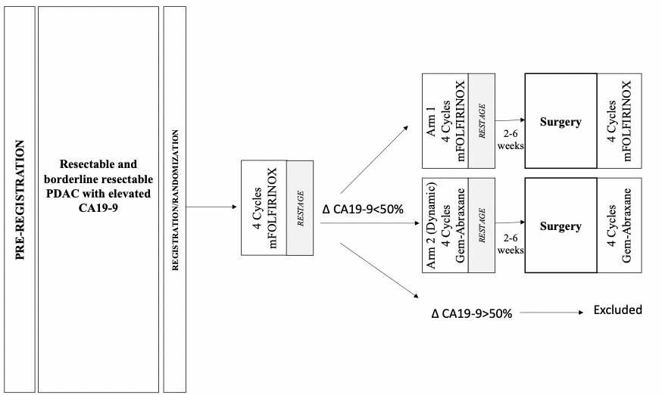
New Multi-Institutional Neoadjuvant Trial

Slide 21
High Risk Clinic

Slide 22
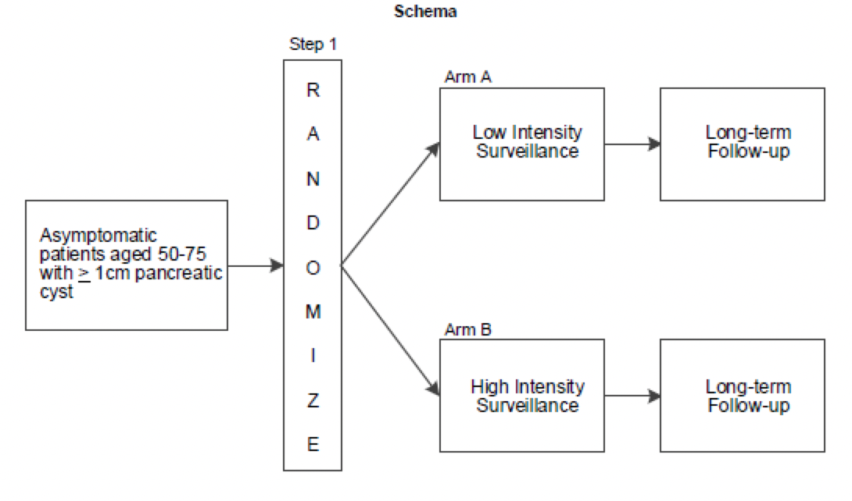

Slide 23
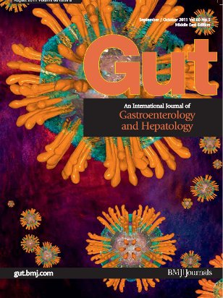
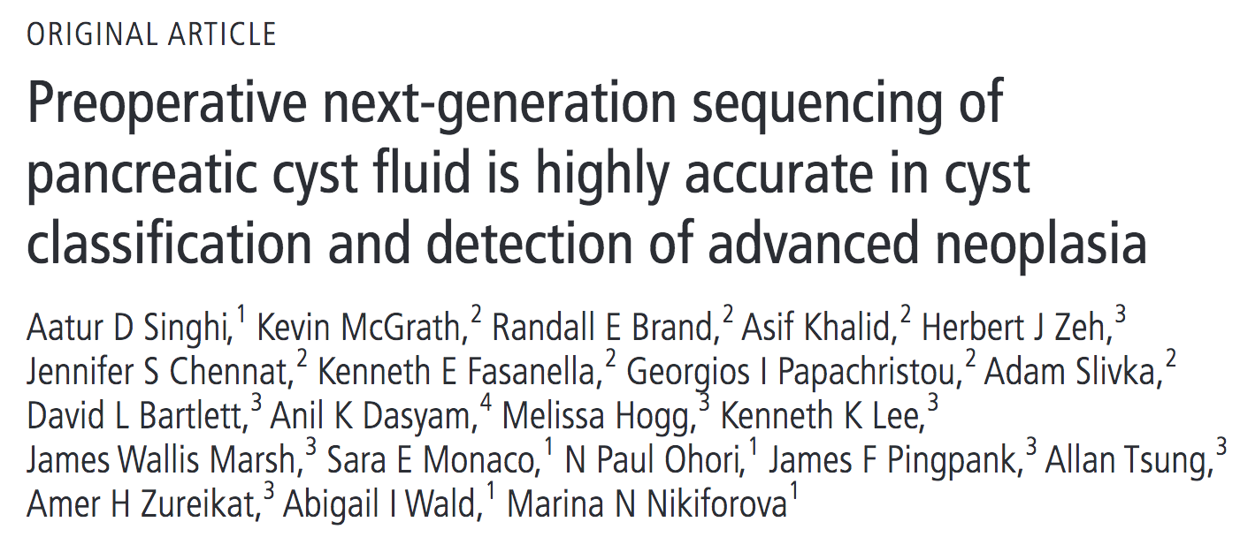
Tp53/pik3ca/pten are high risk mutations

Slide 24
Mostly Bad Luck
10%
Hereditary
20%
Familial
70%
Sporadic
Hereditary
Recognized genetic syndromes with a known germline mutation associated with an increased risk of PC
Familial
Two or more cases of PC (with at least a pair of FDR) without a known mutation.
Chronic Pancreatitis ~6x
Smoking ~2-3x

Slide 25
Hereditary Genetics

Slide 26
Minimally Invasive Approach to Pancreatic Surgery

Slide 27
Best Evidence

Slide 28
Growth of Minimally Invasive Surgery
Robotic: 4.5% → 70.6% in past few years
MIS Improves Outcomes:
Decreased Blood Loss
Increase Lymph Node Harvest
Decreased Hospital Stay
Decreased Wound Infection

Slide 29
Whipple Procedure Steps
Mobilization
Portal Dissection
Uncinate/Retroperitoneal Dissection
Cholecystectomy
Pancreaticojejunostomy
Hepaticojejunostomy
Gastrojejunostomy
Peri-Ampullary
Bile Duct
Ampullary
Duodenal

Slide 30
Uncinate/Vascular Dissection
Video to be added

Slide 31
Distal Procedure Steps
Mobilization
Vascular Dissection and Pancreas Transection
Retroperitoneal Dissection

Slide 32
Body Cancer on Retroperitoneum
Video to be added

Slide 33
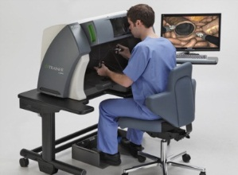
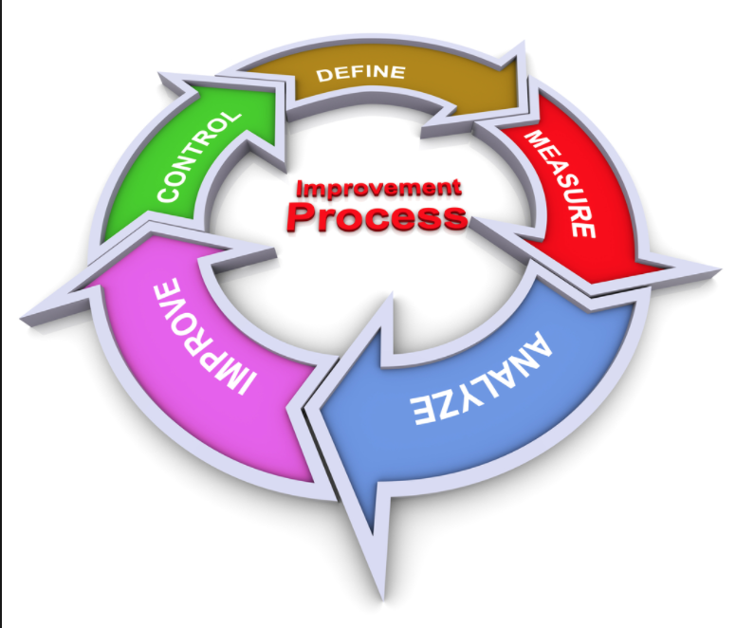
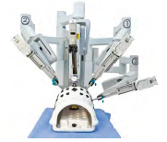
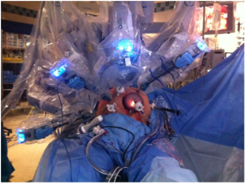
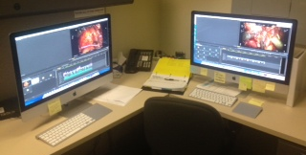
Components of Proficiency Training
Robotic Training
Mastery of the Console
Mastery of Loss of Haptic Feedback
Mastery of the Procedures
Mastery of Psychomotor Performance
Decision Making and Judgment
Step #1
Simulation
Curriculum
Step #5
Ongoing QAQI
Step #2
Inanimate
Curriculum
Step #4
Surgical Curriculum
Step #3
Video Library

Slide 34
Sim video here

Slide 35
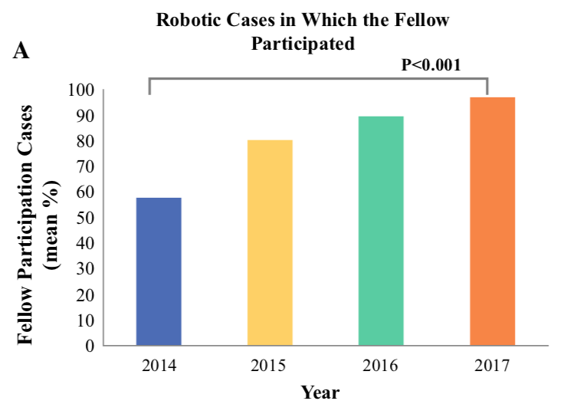
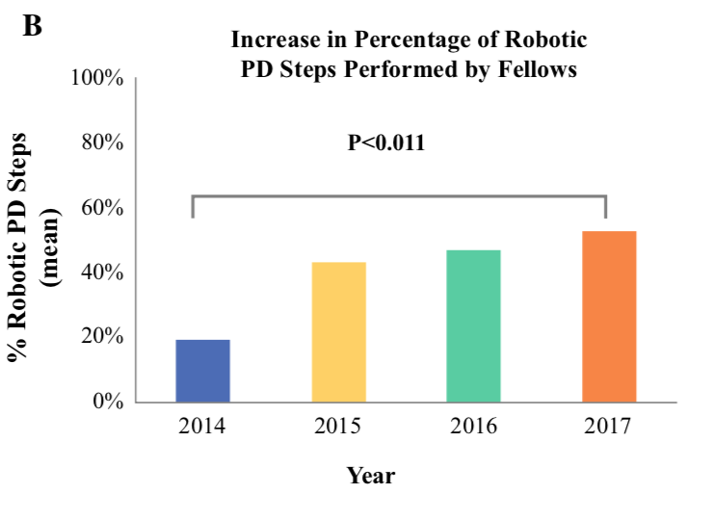
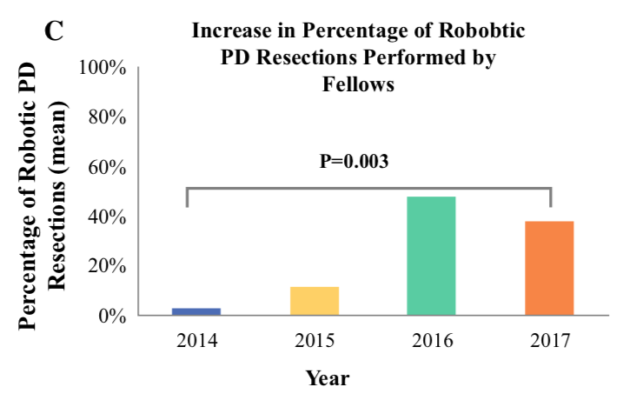
More Time in Simulation = More Time in OR
Case Participation
Whipple Steps
Whipple Resections

Slide 36
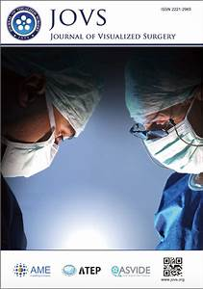
Dissemination – Dutch HPB Surgeons
Resident
Intern
Junior
Fellow
SSO/HPB
Attending
Lab
Senior
Local
Remote
Remote
Other

Slide 37
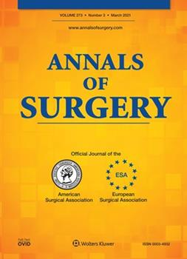
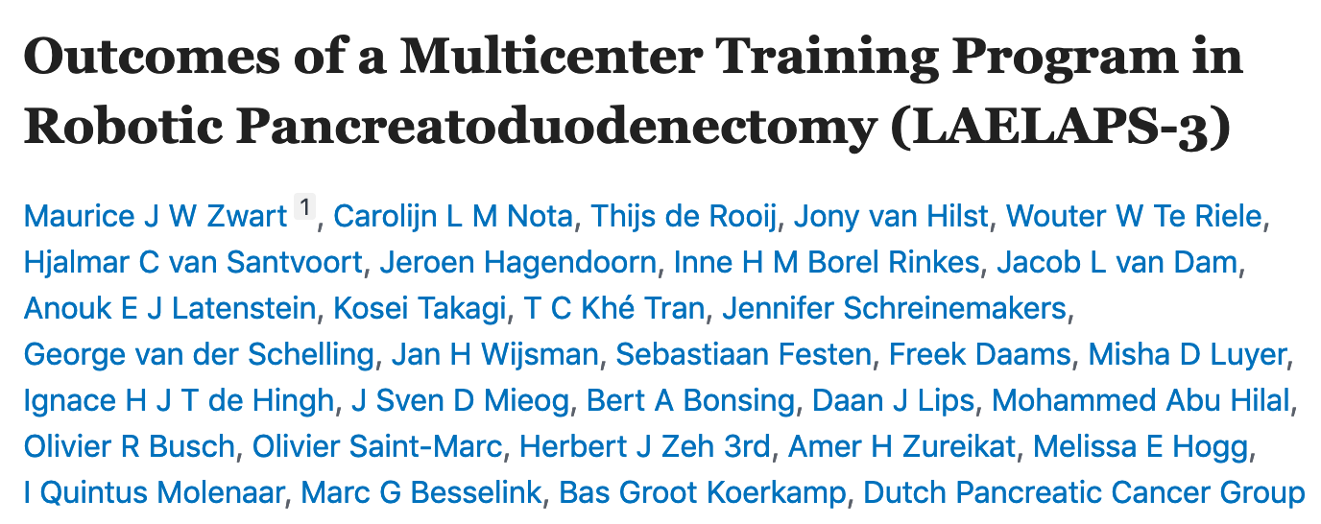
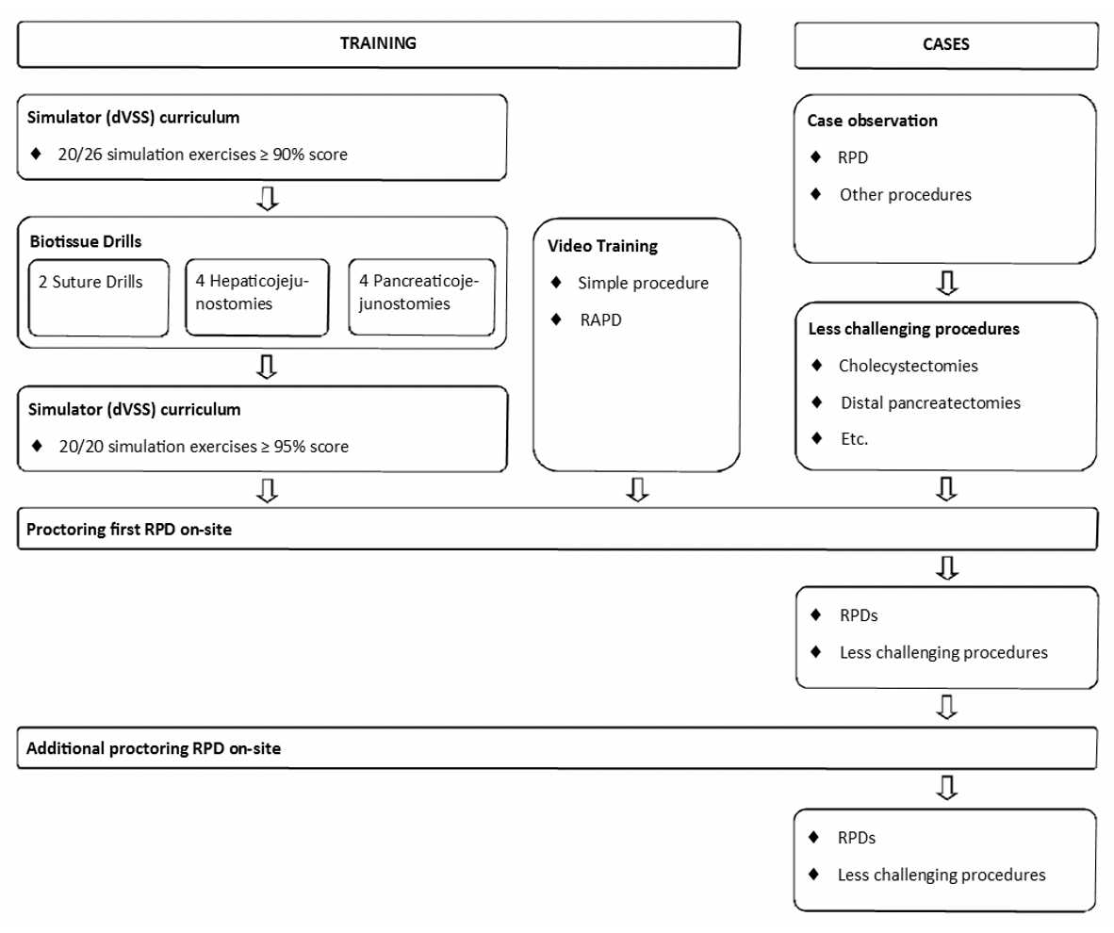
LEALAPS-3 Completion (2016-2020)
Conclusions:
A multicenter RPD training program was found to be feasible with acceptable outcomes during the early learning curve.
No negative impact of the first learning curve phase was detectable.
Future studies should determine the added value of RPD over laparoscopic and open pancreatoduodenectomy.

Slide 38
LEARNBOT Starts in Europe (7/2020)

Slide 39
Resident Training Program @ NorthShore

Slide 40
Chicago Wide Training Program

Slide 41
International Training @ NorthShore

Slide 42
Opportunities for More Program Growth
Multi-Modality Therapy for Pancreatic Cancer
Clinical Trials at Northshore
Multi-Institutional Program Opportunities
High Risk Clinic
Minimally Invasive Approach to Pancreatic Surgery
Training the Next Generation

Slide 43
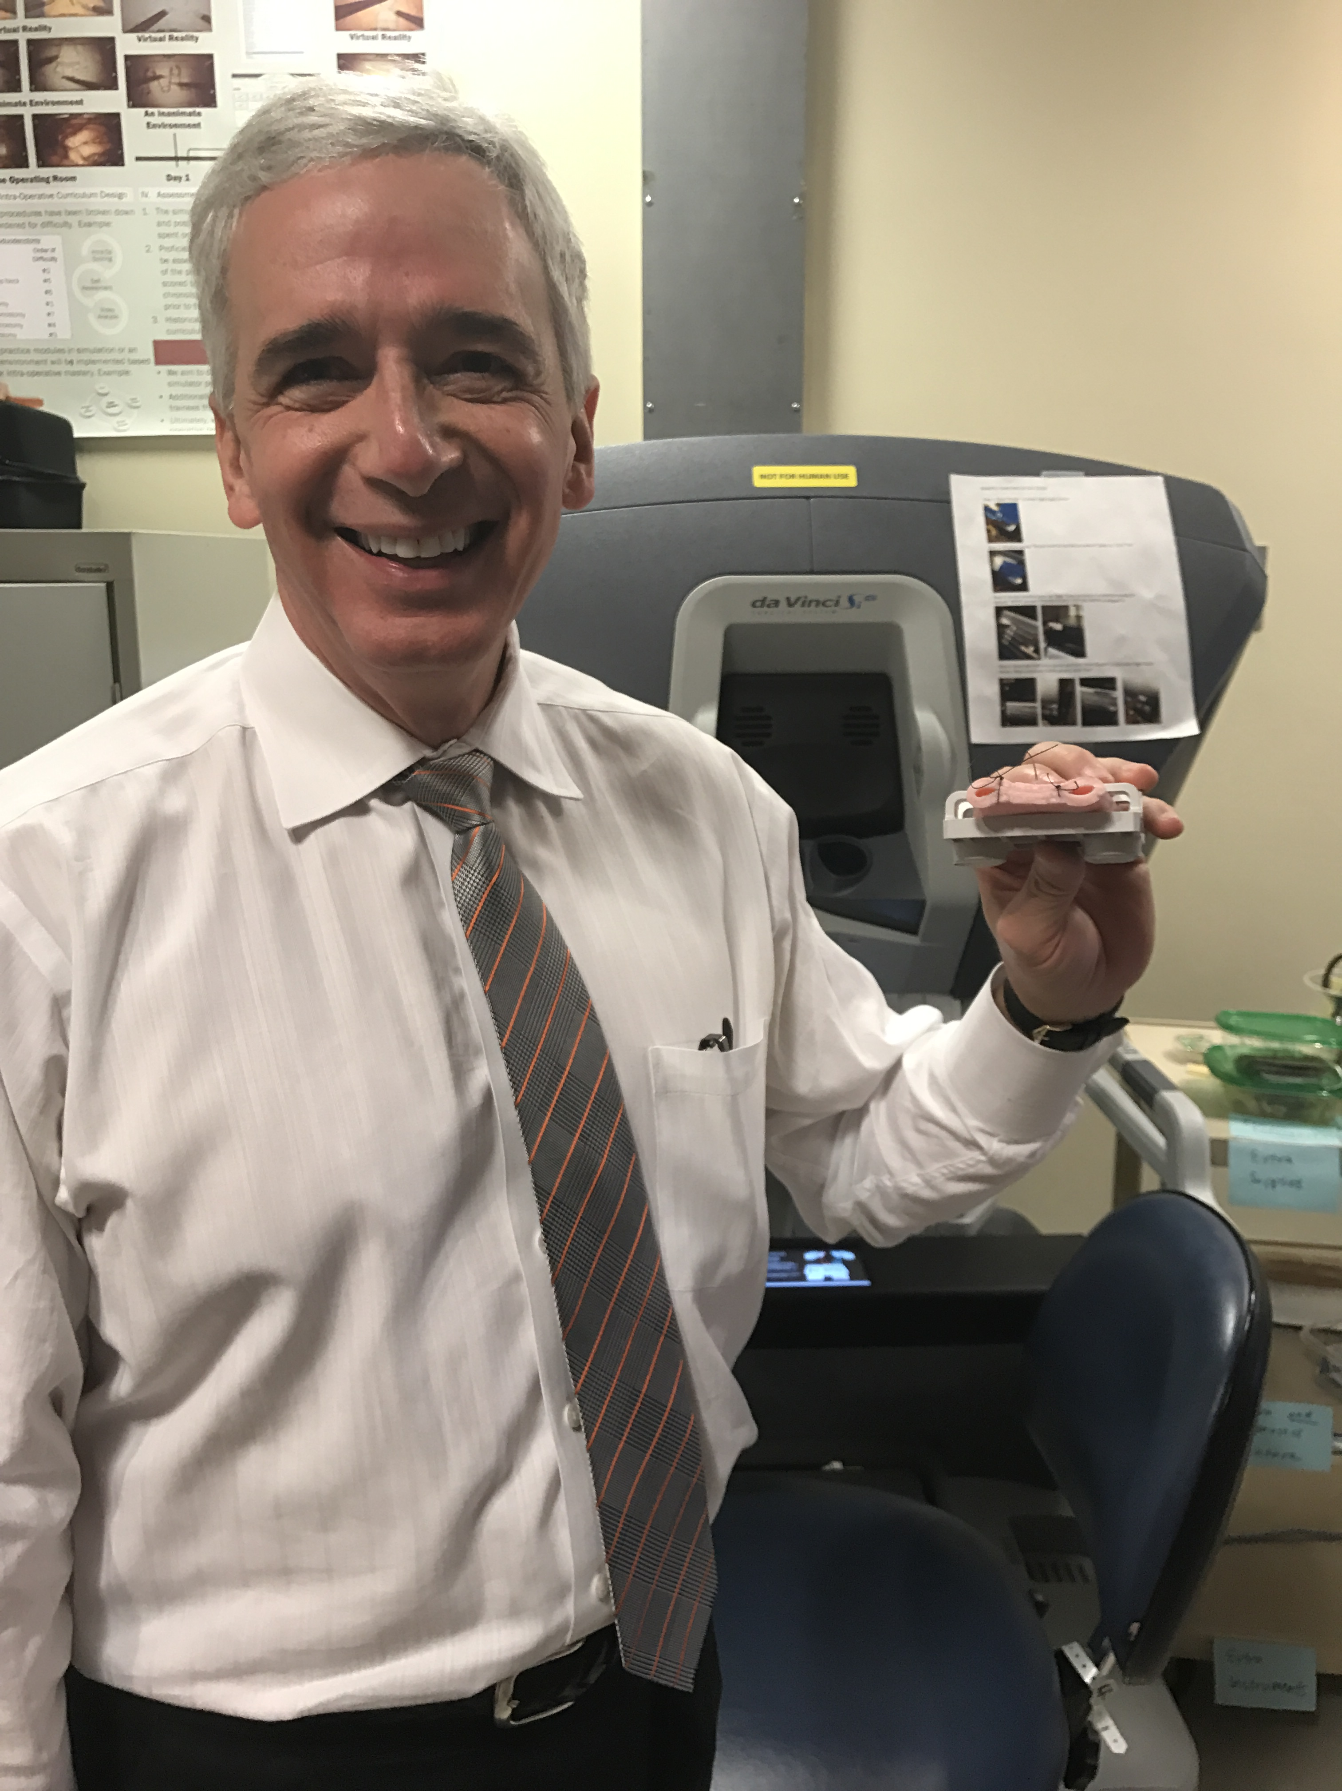
Thank You

