Slide 1
Pancreatic Cancer and Melanoma: 5 Facts You Need to Know
Allison DePersia, MD
Assistant Medical Director
Neaman Center for Personalized Medicine
Endeavor Health

Slide 2
Objectives
Key insights on hereditary cancer syndromes
How genetics affect risk for pancreatic cancer
The genetic risk of melanoma
BRCA2 & CDKN2A genes
Recommended screenings for those at risk

Slide 3
Cancer is common
~ 40% of men and women will develop cancer in their lifetime
Most cancer is sporadic
Many factors affect cancer risk

Slide 4
Cancer Risk Factors
Environment
occupational exposure
Lifestyle
smoking, alcohol consumption, BMI
Genetics
family history, inherited gene mutation
Medical History
pancreatitis

Slide 5
Genetics of Cancer
5-10% of cancers are thought to be related to an inherited change in a gene
Mutation
“Hereditary cancer syndrome”
Cancer.gov

Slide 6
Familial cancer
Cancer that occurs in a person with a family history of disease
shared risk factors, genetics

Slide 7
Hereditary Cancer Syndromes

Slide 8
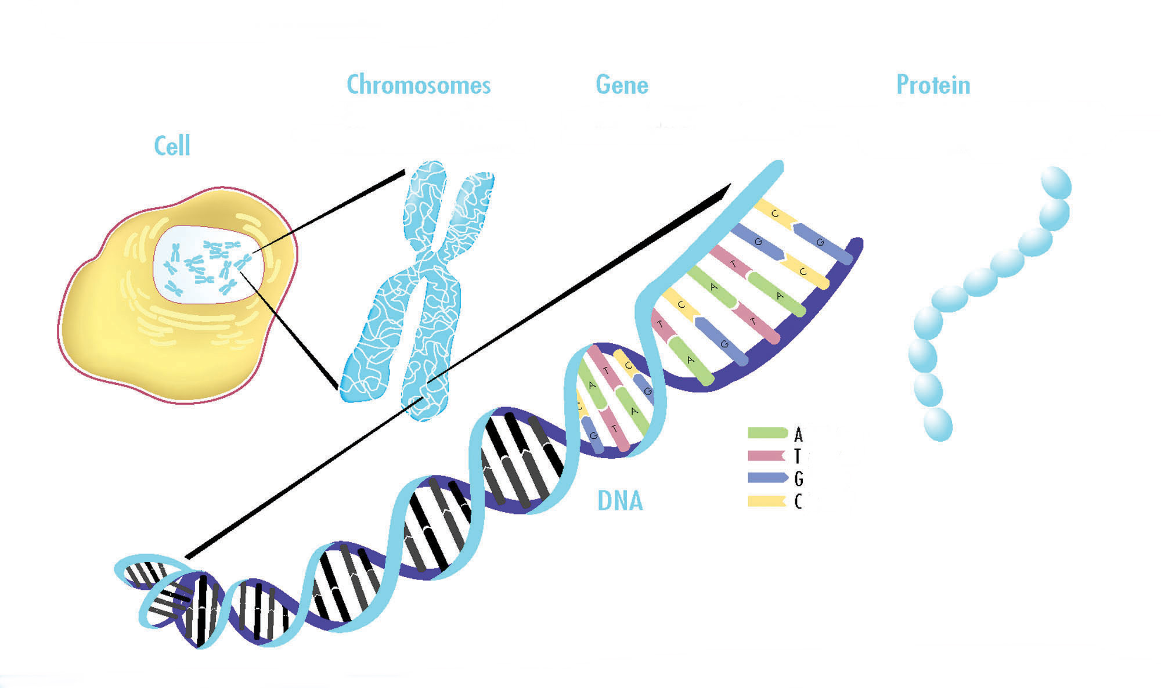
Genetics

Slide 9
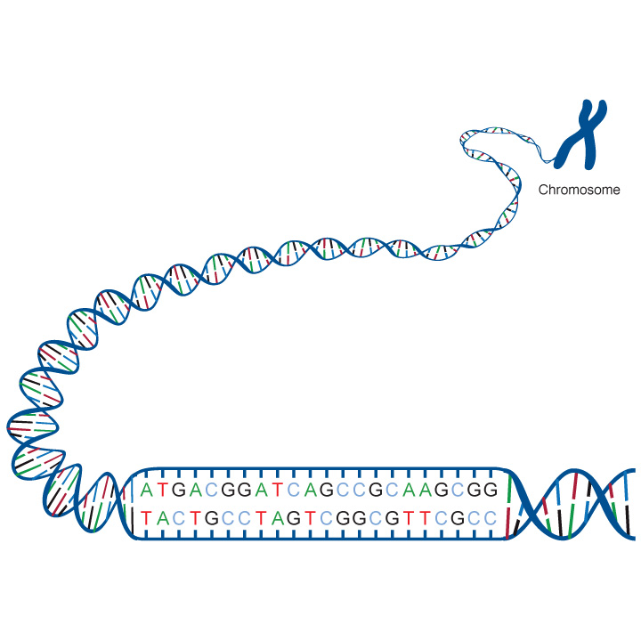
Genes are pieces of DNA
DNA = “manual”, instructs cells to make proteins that control cell function, growth, replication
Genes = “chapters” that DNA is divided into, provide
instructions for a
specific protein
Letter code

Slide 10
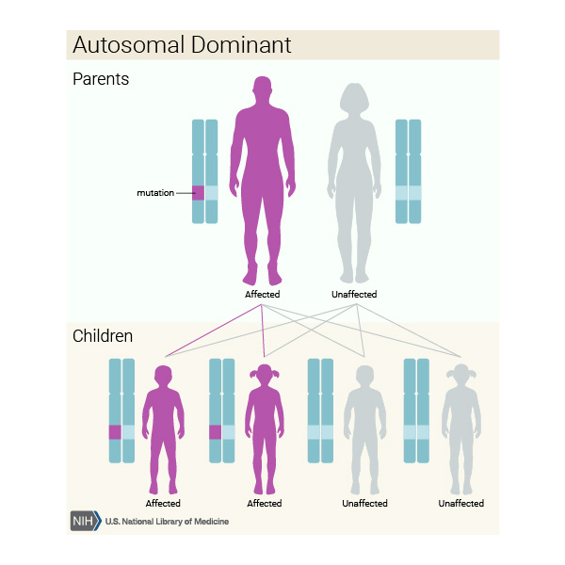

Slide 11
Genetic Mutation
a change in the “spelling” of a gene so that it doesn’t make a fully functional protein
a mutation in a gene meant to help protect us from developing cancer = increased cancer risk
<100% risk (penetrance)

Slide 12
How Cancer Forms
Sporadic cancer
X
X
X
X
X
X
X
X
X
X
X
Normal
Cell
Loss of Proper
Growth Control
Tumor Develops
Hereditary cancer
X
X
X
X
X
X
X
X
X
X
X
Predisposed
Cell
Loss of Proper
Growth Control
Tumor Develops

Slide 13
Why would someone want to know if they have a hereditary cancer syndrome?
more precise cancer risk estimate
opportunity to be proactive:
targeted cancer treatment
Increased cancer screening
Risk reduction
Surgery
Medication

Slide 14
High Risk of Pancreas Cancer
Pancreatic Ductal Adenocarcinoma (PDAC) (94% pancreas ca)
General population ~1.5% lifetime risk of developing pancreatic cancer
High risk ~5% lifetime risk or 5 fold
Hereditary pancreas cancer (focus)
Familial pancreas cancer (at least 2 first degree relatives)
Notes:
Familial – family clustering

Slide 15
Genetics of Pancreas Cancer
Pancreas cancer: ~10% genetic
More likely to be genetic if:
Young diagnosis
Family history
Other cancer history
All patients with pancreatic cancer should be offered genetic testing

Slide 16
Genetics of Melanoma
7-15% have a family history of melanoma
5-10% due to hereditary mutation
20-40% due to CDKN2A
Familial melanoma (2 first degree relatives or 3 or more cases on the same side of the family

Slide 17
Inherited cancer predisposition syndromes: Pancreatic Cancer & Melanoma
CDKN2A (FAMMM: Familial Atypical Multiple Mole Melanoma Syndrome)
0.3-0.4% patients with PDAC
BRCA2 (HBOC: Hereditary Breast and Ovarian Cancer Syndrome)
~5-9% patients with PDAC

Slide 18
Other Hereditary Pancreatic Cancer Syndromes
ATM
BRCA1
PALB2
Lynch Syndrome (MSH1, MSH2, MSH6)
Peutz-Jeghers Syndrome (STK11)
Li Fraumeni Syndrome (LFS)
Hereditary Pancreatitis (PRSS1, SPINK1)
Notes:
Peutz-Jeghers Syndrome (PJS) is an autosomal dominant inherited syndrome characterized by mucocutaneous pigmentation, hamartomatous polyposis in the gastrointestinal tract, and a strongly increased risk of both gastrointestinal and extra-intestinal malignancies.
Repetitive pancreatic injury, as is the case in hereditary pancreatitis, increases risk of malignancy

Slide 19
CDKN2A: Familial Atypical Multiple Mole Melanoma Syndrome
Multiple melanocytic nevi
Increased risk of melanoma (28%–76%)
Age 30-45
Increased risk of pancreas cancer (>15%)
late 50s
Notes:
Some estimates up to 19%
Youngest melanoma case age 13 reported in lit
Skin screening start age 10

Slide 20
CDKN2A screening
Pancreas screening starting at age 40 or 10 years younger than youngest affected relative
MRCP (magnetic resonance cholangiopancreatography) and EUS (endoscopic ultrasound)
Dermatology screening every 6 months
NCCN: Genetic/familial High-Risk Assessment: Breast, Ovarian, and Pancreatic
CAPS Guidelines (Cancer of the Pancreas Screening Program)
Notes:
Endoscopic retrograde cholangiopancreatography

Slide 21
Screening Outcomes
Goal: pre-symptomatic
More likely to be early stage (I, II 70% v. 30%)
surgically resectable
Less likely to be metastatic (27% v. 54%)
Improved 3 and 5 year survival
Median overall survival 62 months v. 8 months
Blackford et al. JAMA Oncol July 2024

Slide 22
BRCA2: Hereditary Breast and Ovarian Cancer Syndrome
Breast cancer >60%
Ovarian cancer 13-29%
Pancreas cancer 5-10%
BRCA1 </=5%
Prostate cancer 19-61%
Melanoma (not available)

Slide 23
BRCA2: Screening
Breast cancer: Annual mammogram and MRI (age 25) or risk reducing mastectomy
Ovarian cancer: bilateral salpingo-oophorectomy (age 40-45)

Slide 24
BRCA2: Screening
Pancreas: age 50+ IF family history, MRCP and EUS
ASGE guidelines consider screening for all age 50+
Screening outcomes – same data applies
Prostate cancer: PSA (age 40)
Melanoma: annual whole body skin exam with dermatology

Slide 25
Resources at Endeavor Health
Neaman Center for Personalized Medicine
Hereditary cancer Genetic testing
High risk cancer screening
General Medical Genetics
High Risk Pancreas Clinic:
Dr. Allison DePersia & Dr. Melissa Hogg
1000 Central Street, Evanston, IL
Office phone: 847.570.1029

